Slide 1
Chapter 6 Type Checking

Slide 2
Overview

Slide 3
Static Checking
Check that the source program follows both the syntax and (static) semantic conventions of the source language.
e.g. Types of operator & operands match ?
Improves the security of systems

Slide 4
Position of Type Checker
Type
checker
Intermediate code generator
Token stream
parser
Syntax tree
Syntax tree
Intermediate representation
A type checker verifies that the type of a construct matches that expected by its context.
Type information gathered by a type checker may be needed when code is generated.

Slide 5
Type Systems

Slide 6
Type Expressions ₍₁₎
A basic type is a type expression.
A type name is a type expression.
A type constructor applied to type expression is a type expression.
Constructors include:
  Arrays, products (a tuple of type, e.g.,parameter list), records, pointers, functions (mapping from product to return type)

Slide 7
Type Expressions ₍₂₎
Type expressions may contain variables whose values are type expressions.
Compiler-generated type variable

Slide 8
Example
type row = record
address: integer;
lexeme: array[1..15] of char
end;
Record((address*integer)*(lexeme*array(1..15, char)))

Slide 9
Example
var p: ↑ row
pointer(row)
mod(i, j: int): int
int * int → int

Slide 10
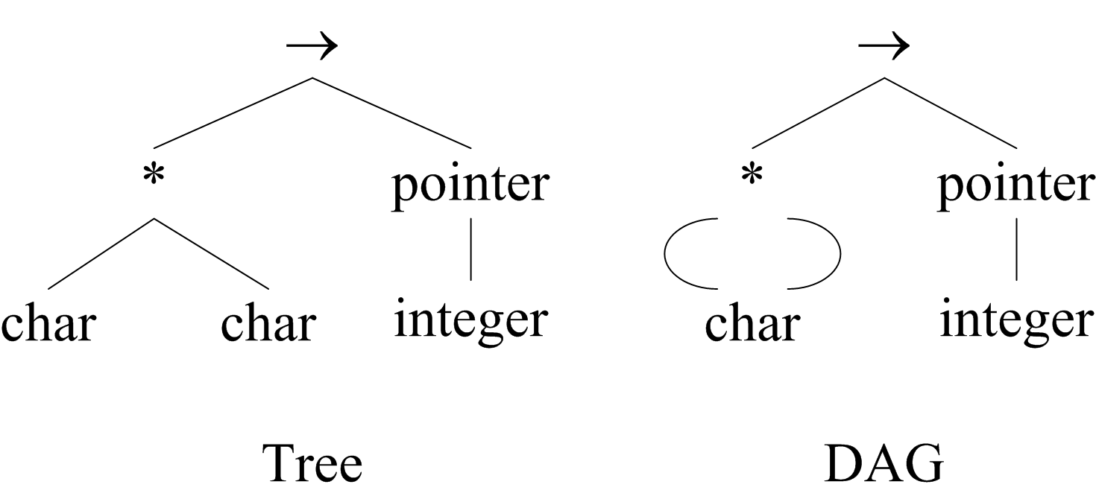
Represent a type expression by a graph (Type Structural equivalence)
function f(a, b: char): ↑ integer
char * char → pointer(integer)

Slide 11
Type Systems
A type system is a collection of rules for assigning type expressions to the various parts of a program.
(1) A type checker implements a type system.
(2) The type systems are specified in a syntax-directed manner.

Slide 12
Static and Dynamic Checking of Types
Static Checking (Done by a compiler)
Dynamic Checking (done when the target program runs)
  table: array: array[0..255] of char;
  i: integer;
  …
  table[i] := ‘a’ // Check index of array

Slide 13
Static and Dynamic Checking of Types
Strongly typed language (if its compiler can guarantee that the programs it accepts will execute without type error)

Slide 14
Specification of a Simple Type Checker

Slide 15
a Simple Language

Slide 16
Grammar for the Source Language
P→D; S
D→D;D | id:T
T →
char | integer | array [num] of T | ↑T
E →
literal | num | id | E mod E | E[E] | E↑

Slide 17
Translation Scheme ₍₁₎
P→D;S
D→D;D
D→ id:T {addtype(id.entry, T.type)}
T →char {T.type=char}
T → integer {T.type=integer}

Slide 18
Translation Scheme ₍₂₎
T → array [num] of T₁ {T.type=array(1..num,T₁.type)}
T → ↑ T₁ {T.type=pointer(T₁.type)}

Slide 19
Type Checking of Expressions
E → literal {E.type = char}
E → num {E.type = integer}
E → id {E.type = lookup(id.entry)}
E → E₁ mod E₂
{E.type= if (E₁.type==integer) && (E₂.type==integer) integer else type_error}

Slide 20
Type Checking of Expressions
E →E₁[E₂]
{E.type= if (E₂.type==integer) && (E₁.type==array(s, t) t else type_error}
E →E₁ ↑ 放在右边的是解地址
{E.type = if (E₁.type==pointer(t)) t else type_error}

Slide 21
Type Checking of Statements
S → id:=E
{S.type= if (id.type==E.type) void else type_error}
S →if E then S₁
{S.type= if (E.type==boolean) S₁.type else type_error}

Slide 22
Type Checking of Statements
S →while E do S₁
{S.type= if (E.type==boolean) S₁.type else type_error}
S → S₁;S₂
{S.type= if (S₁.type==void) && (S₂.type== void) void else type_error}

Slide 23
Type Checking of Functions
E →E(E)
T → T₁ ‘→’ T₂ {T.type= T₁ .type→ T_{2 .}type}
E →E₁ (E₂)
{E.type = if (E₂.type==s) &&(E₁.type==s→t) t else type_error}

Slide 24
Structural Equivalence of Type
The same basic type.
Formed by applying the same constructor to structurally equivalent types.

Slide 25
Names Equivalence of Type
type link = ↑cell
type np = ↑cell
var next: link;
last : link;
p : np
q : ↑cell;

Slide 26
Cycles in Representations of Types
type link = ↑cell;
cell = record
info : integer;
next : link
end;

Slide 27
Type Conversion
Conversions
  Implicit type conversions
  Done by compiler
  x + i
Explicit conversions
  Designated by the programmer
  Char(55)

